Slide 1
University American College Skopje
Course: Business Computer Applications
Integration and collaboration in business environment using Office 365 tools
Marija Stanojeska, PhD

Slide 2
Microsoft One Drive

Slide 3
One Drive
OneDrive is a cloud-based file hosting service provided by Microsoft as part of its suite of Office Online services. In essence, OneDrive itself is a cloud computing service. The characteristics as follow:
OneDrive is a cloud storage service that allows users to store files and data in the cloud.
Users can access their files stored on OneDrive from various devices with an internet connection.
OneDrive offers scalable storage, allowing users to increase or decrease their storage space based on their needs.
OneDrive supports collaboration by allowing users to share files and folders with others, facilitating real-time collaboration on documents.
OneDrive provides automatic synchronization of files between devices, ensuring that the latest version of a file is available on all linked devices.
OneDrive includes security features such as encryption and backup options to protect user data.
OneDrive is often integrated with other Microsoft cloud services, such as Microsoft 365 (formerly Office 365), providing a seamless experience for users.
OneDrive is an example of how cloud computing is utilized to provide scalable, accessible, and collaborative storage solutions. It illustrates how cloud services can be integrated into daily productivity tools to enhance data management and collaboration capabilities for users and businesses.

Slide 4
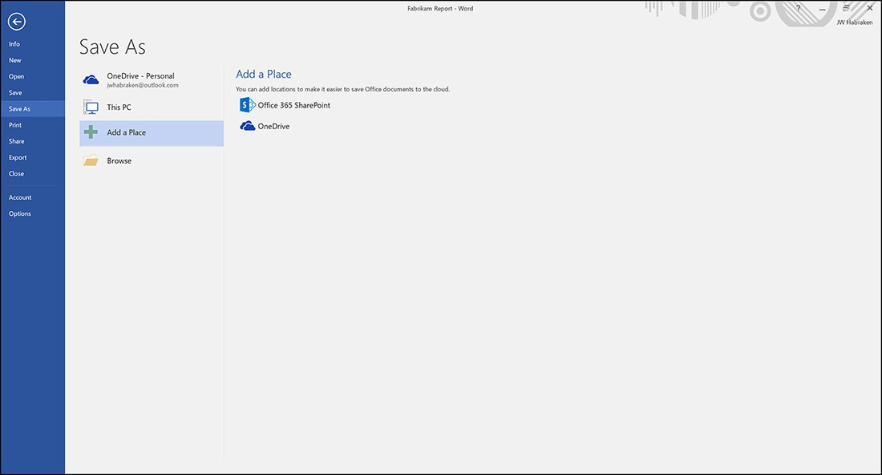
Saving Oﬃce application ﬁles to the cloud
Figure shows the Save As page in the Word Backstage. One cloud location, OneDrive – Personal, has already been conﬁgured. You can add additional cloud locations, including OneDrive sites and SharePoint sites, by selecting Add A Place. To actually log in to one of the cloud options and add it as a place, select one of the options in the Add A Place list such as Oﬃce 365 SharePoint or OneDrive.

Slide 5
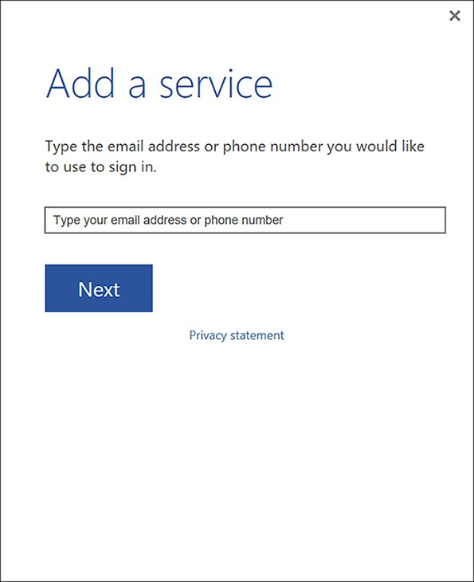
Saving Oﬃce application ﬁles to the cloud (cont.)
When you select one of the cloud options, the Add A Service dialog box opens, enter the email address that serves as the login name for the service and then select Next. On the next screen, supply the password for the account and then select Sign In. The new service will be added to the list of cloud options on the Save As page. When you add a place, such as a OneDrive site, to one of the Oﬃce applications, you are adding it to all the Oﬃce applications. You will ﬁnd that the process for accessing these sites is very consistent and similar across the Oﬃce applications, particularly Word, Excel, and PowerPoint. The process is a little diﬀerent from Oﬃce “standards” such as Word and Excel.

Slide 6
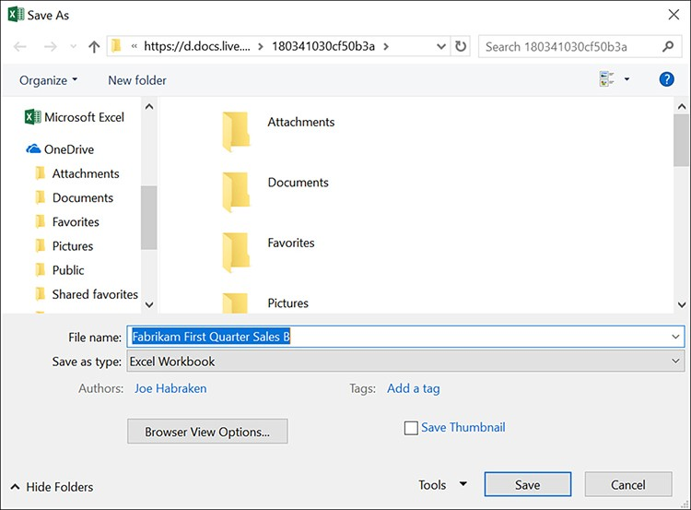
Saving a ﬁle to OneDrive or OneDrive for Business
You can select any of the recent folders to open the Save As dialog box. Depending on when you last accessed your OneDrive, you might be asked to provide your user email and password to connect to it. Figure shows the Excel Save As page and a ﬁle that will be saved to the user’s OneDrive. Notice in the Organize pane (on the left of the Save As dialog box) that the user’s OneDrive appears on the directory tree provided. When you have speciﬁed the location in the Save As dialog box for the ﬁle, select Save. The Excel workbook is saved to the cloud place.
Opening ﬁles that you saved to your OneDrive or other cloud place is no diﬀerent from opening a ﬁle stored locally. In the Oﬃce application’s Backstage Open page (or the new Start screen provided by the Oﬃce applications), recently saved ﬁles are listed. If you saved a ﬁle to the cloud and it’s listed in the Recent list, select the ﬁle to open it.

Slide 7
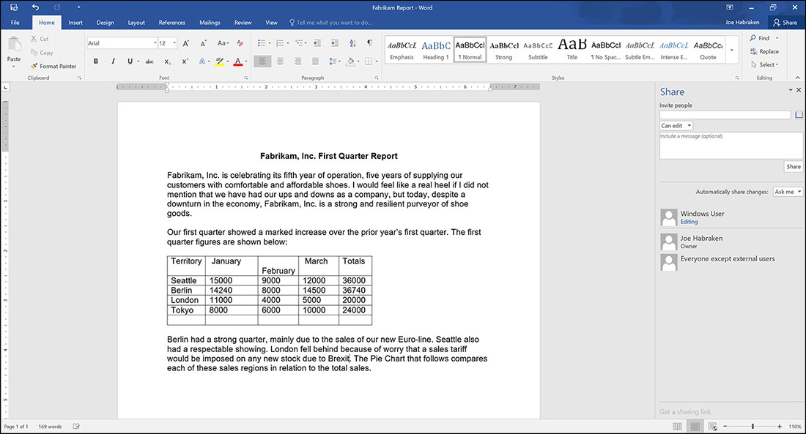
Sharing a file saved to the cloud
Sharing a ﬁle via Excel or PowerPoint will use the same process. With the document you wish to share open in Word, select the Share icon on the far right of the Word application window (just above and to the right of the Word ribbon). This will open the Share task pane on the right of the Word window. If the document has not been saved to one of your cloud locations, the Share ask pane will provide a Save To Cloud button. When you select this button, you will be taken to the Backstage’s Save As page. Save the document to your OneDrive. Once you have the ﬁle saved to your OneDrive and you return to the Word application window, you will ﬁnd that the Share ask pane is now ready to share your document with other users.

Slide 8
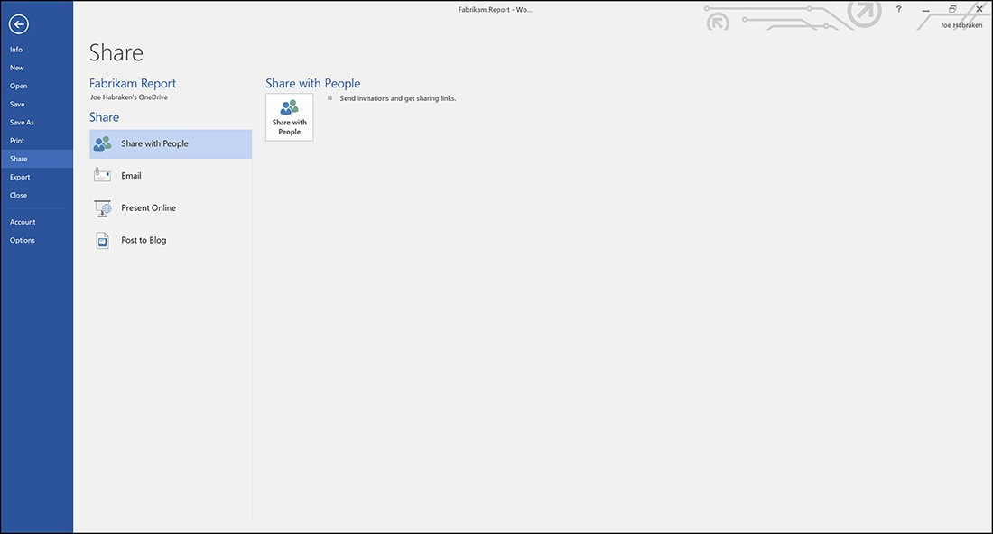
Sharing a file saved to the cloud
To share the current document with another user, you can enter an email address in the Invite People box, or you can select the Search. The Address Book For Contacts icons to add people from your Outlook Contacts folder (or distribution lists if available). Once you have entered an email address, use the drop-down menu below the email address to determine if the user Can Edit or Can View. A message box is also provided for an optional message to the user. After you are ready to share the document with the individual, select the Share button.
If you would like more sharing options, you need to go to the Backstage Share page (Select File, and then Share) The Word Share page is indicative of what you ﬁnd in the other Oﬃce applications. The options are: Share With People, Email, Present Online, Post To Blog,

Slide 9
Using the Word Online app
The Word Online app provides you with the ability to edit existing documents (stored in the cloud) and create new documents. It supplies some commands for working with text, including character- formatting and paragraph-formatting attributes. It also provides you with the ability to insert tables and pictures into a document. The document views in the Word Online app are limited to the Editing view and the Reading view.
You can download a copy of your document as a PDF (which is great if a collaborator wants to see the document and doesn’t need to edit it), and you can download the ﬁle as an ODT ﬁle (OpenDocument Text format). This format is supported by Oﬃce (actually 2007 and newer) and is compatible with Word Online. The ﬁle format can give you a little more ﬂexibility in terms of sharing the document with users who don’t have Oﬃce available to them.
The Word Online app provides you with four ribbon tabs: File, Home, Insert, and View. The ribbon also provides a convenient Open in Word command that allows you to open the current document in the installed version of Word if it is present on the device you are using.

Slide 10
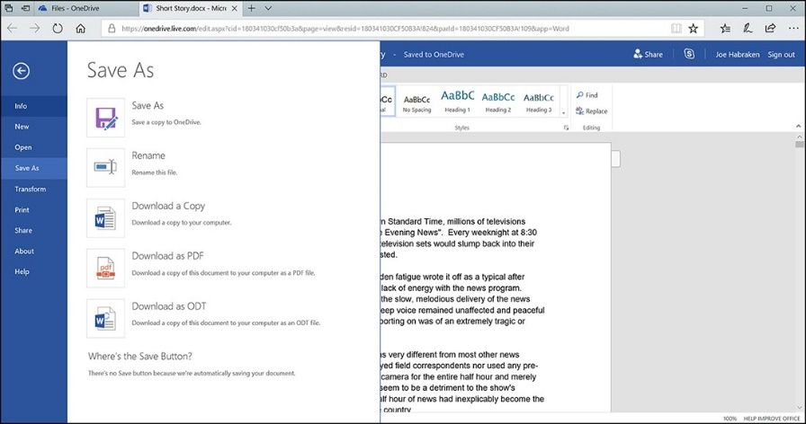
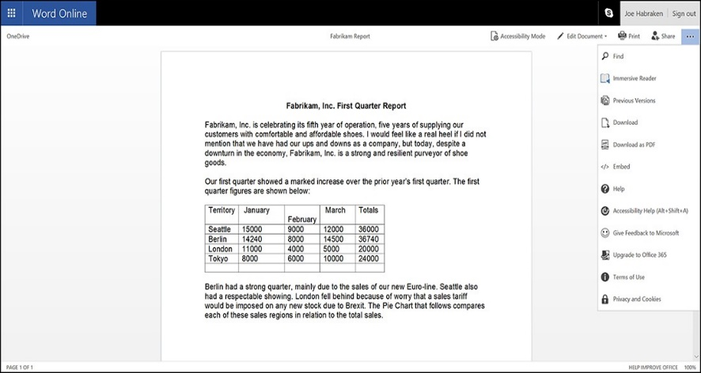
The Word Online app’ s File tab
The File tab provides you with access to the Word Online app’s Backstage. The Backstage provides you with the ability to open the current document in your installed Word application via the Info tab. It also enables you to save the changes that you have made to the document (Save) and access Save As. The Word Online app’s Save As page is shown in Figure bellow. The Word Online app’s Backstage also provides access to a Share page and a Print page. The Sharing options allow you to invite other people to view or edit the document, and you can embed the document in a blog or website to share it.
The Print page doesn’t allow you to send the document to a printer, but it does allow you to create an Adobe Acrobat ﬁle from the ﬁle currently open in the Online app.

Slide 11
Working in the Excel Online app
The Excel Online app provides a pretty strong subset of the Excel commands, so you can build sheets that take advantage of Excel’s function library and its ability to manipulate table data as well as visually portray your data in a variety of chart types.
Basic features are covered in the Excel Online app, and you can adjust row heights and column widths in a worksheet by dragging the row or column border. The Best-Fit column width function (double-clicking a column border) is now also available in the Online app, so you can easily size columns to accommodate the longest entry in a particular column. As already mentioned, you can insert
new sheets into your workbook, and you can delete a sheet in the workbook by right-clicking the sheet tab and selecting Delete. You can also rename worksheets as needed.
You can view graphics that you have added to a worksheet created in Excel, such as pictures, clip art, and SmartArt, but you do not have the formatting control over them that you do in the installed version of Excel. You can move a graphic such as a picture on a page in the Online app and resize the picture as needed. You can also remove a picture (or other sheet object) by selecting the object and then pressing Delete on the keyboard.

Slide 12
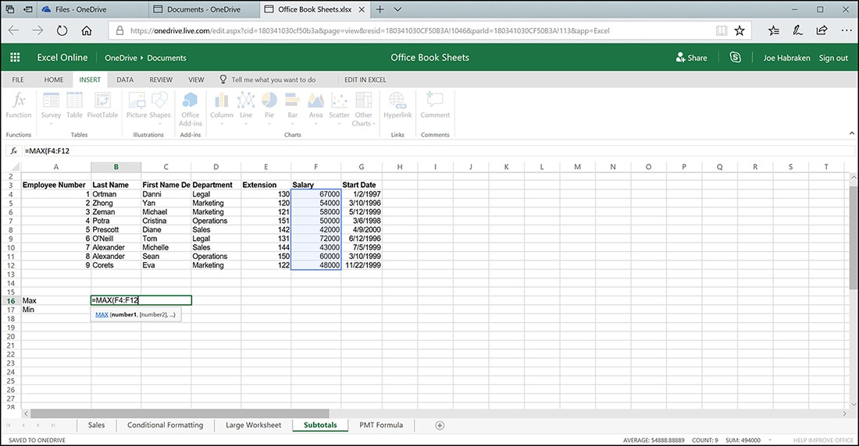
Inserting functions and charts in the Excel Online app
Inserting functions into a worksheet when you are working in the Excel Online app can be accomplished using the AutoSum drop- down menu provided on the ribbon’s Home tab (in the Formulas group) or the Function command provided on the Insert tab.
Selecting More Functions on the AutoSum command (on the Home tab) or selecting the Function command (on the Insert tab) opens the Insert Function dialog box, as shown in Figure. Select a function category in the Insert Function dialog box and then pick the function you want to insert into the currently selected cell. Click OK, and the function is inserted into the sheet; however, you still need to specify the range of cells to be used by the function. For example, in Figure the MAX function is used to compute the maximum salary in a range of salary data. Simply select the range of cells that you want the function to act upon.

Slide 13
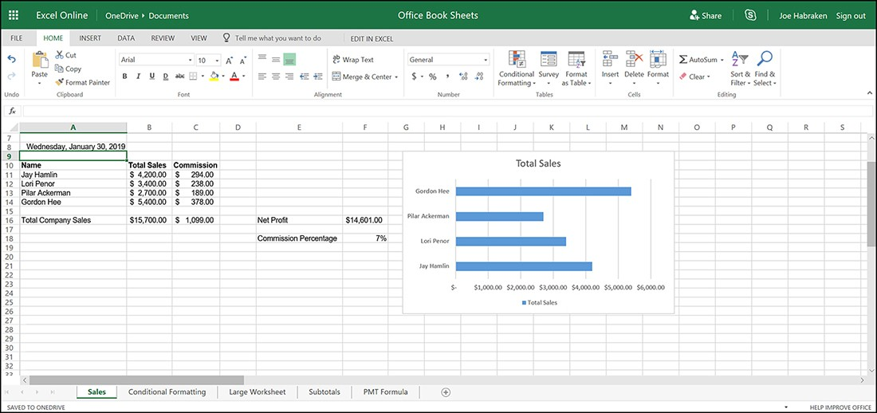
Inserting functions and charts in the Excel Online app (cont.)
You can also add your own formulas to a sheet when you are working in the Excel Online app. To add a formula, type the equals sign (=) and then specify the cell addresses and the operators required for the formula. You can use the mouse to specify the cell addresses that appear in the formula as you would in Excel. When the formula is complete, press the Enter key.
You can also insert charts into your sheets when you are using the Excel Online app. Select the cells that will serve as the chart data. On the Insert tab, select one of the chart types. Each chart type provides chart subtypes. Select one of the subtypes, and the chart is inserted into the sheet. When the chart is selected, the Chart Tools are available on the ribbon.

Slide 14
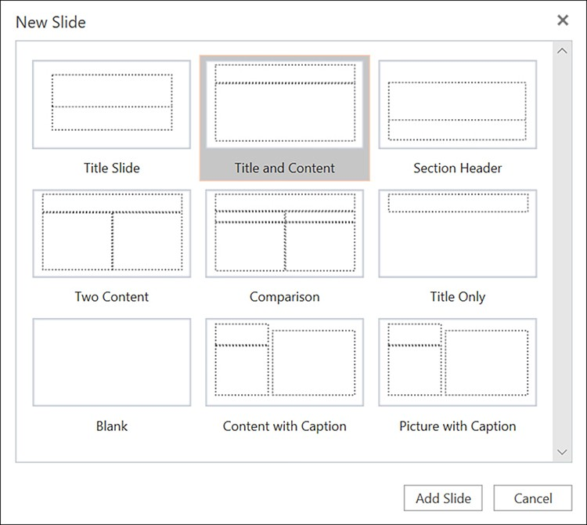
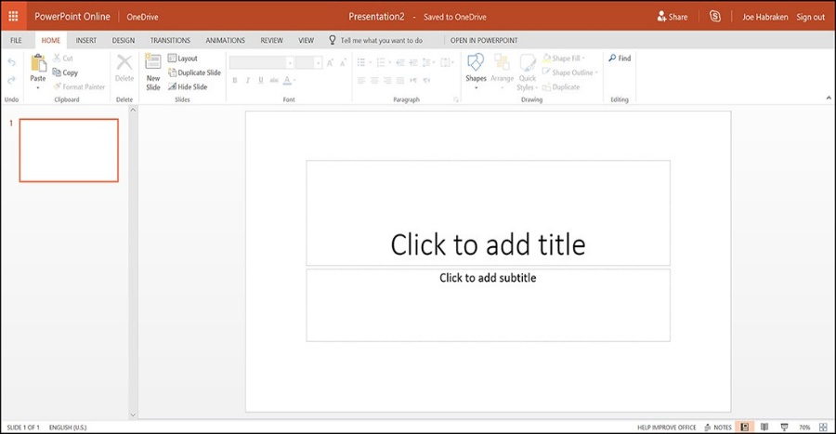
Inserting functions and charts in the Excel Online app
The PowerPoint Online app provides you with a solid collection of commands for creating a new presentation or editing an existing presentation that you have saved to your OneDrive or SharePoint site library. To assign a theme to the new presentation (which opens with a title slide), select the ribbon’s Design tab and then choose one of the themes from the Themes gallery. You can also use the Variants gallery to ﬁne-tune your selected theme.

Slide 15

Quick “In class Mock test”
What is a free online storage space you can use as your own personal hard drive?
  One Drive
  One Note
  Hard Drive
  Email

Slide 16
Quick “In class Mock test”
What is a suite of online applications that lets you create Word documents, Excel spreadsheets, and more?
  Microsoft Office Online
  Web Email
  Google Chrome
  Microsoft Word

Slide 17
Quick “In class Mock test”
Where will a document created with Office Online be saved?
  Hard Drive
  Email
  Documents
  One Drive

Slide 18
Quick “In class Mock test”
What are the advantages of One Drive?
  Download Files
  Upload Files
  Create Documents Online
  Edit & Share without having to download

Slide 19
Useful links
Basics of Zoho CRM
https://www.youtube.com/watch?v=x2SuRIFjimI
Microsoft Copilot for Service
https://www.youtube.com/channel/UCJGCg4rB3QSs8y_1FquelBQ
Microsoft Viva Sales generative AI experience
https://www.youtube.com/watch?v=xBJByeiLwEQ&list=PLcakwueIHoT-ErQZPP80qNKuEAr0wAAD9&index=2
https://www.microsoft.com/en-us/dynamics-365#modal-12
https://www.microsoft.com/en-us/dynamics-365#modal-2

Slide 20
Thank you for your attention!

